Slide 1
ESG ODA Assessment
Product deck

Slide 2
Bain uses three different products to assess ESG in diligences, ranging from a simple diagnostic to an ESD ODA and an ESG due diligence
1 | ESG diagnostics
2 | ESG ODA Assessment
3 | ESG due diligence
Standardized ESG scan to obtain an initial view on key ESG issues in target’s sector, level of materiality & value creation levers
Full ESG assessment including quantification of value drivers, resource requirements & monetization potential on ESG topics, fully integrated with other DD streams
Industry ESG Profile
Industry ESG maturity level & key material ESG topics to focus on basis customer, regulatory, investor etc. PoV
ESG “materiality assessment”
Initial view on potential ESG DD questions
Peer Benchmarking
Detailed qualitative ESG value creation opportunities for target
Quantitative and qualitative Target’s positioning compared to peers and best-in-class
Detail on benchmarking of competitors and/ or product types on each material ESG topic
Value Creation
Key growth and differentiation opportunities for the Target; quantified value creation potential and investments needed
Provides quick initial view on Target industry’s key material ESG issues and levels of materiality
Highlights scope for key DD questions on ESG assessment
Assessment of the point of departure, risk mitigation and qualitative ESG value creation opportunities through benchmarking and industry analysis
Include full quantification and deep-dives on value creation initiatives and implementation roadmap
Use case: Proposals / ODAs, Fund portfolio reviews Timeline: 1 day effort
Use case: Deals with low/medium ESG importance
Timeline: 1.5 - 2 days
Use case: Deals where ESG plays a major role Timeline: 1-3 weeks

Slide 3

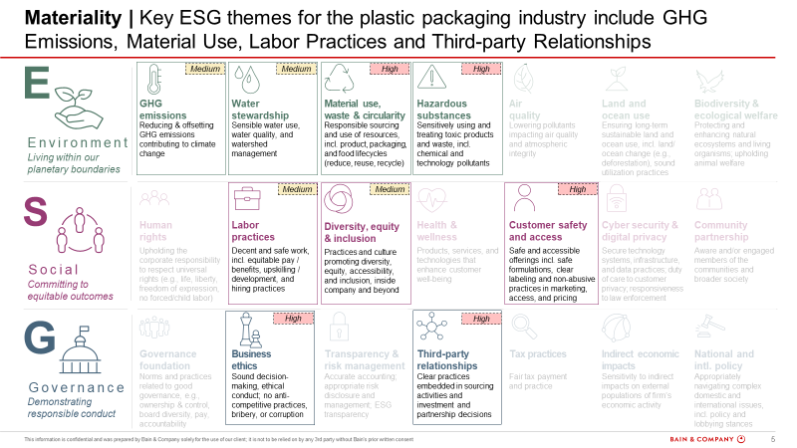
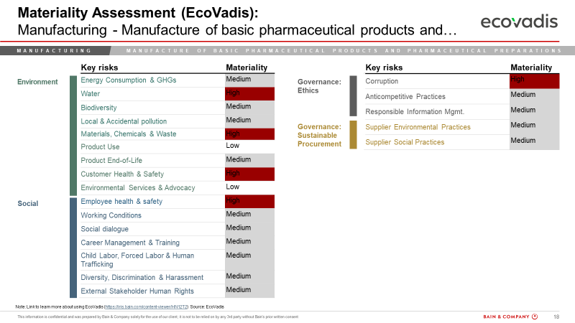
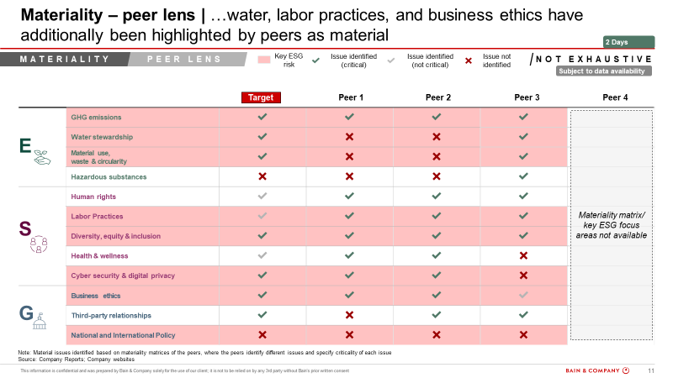

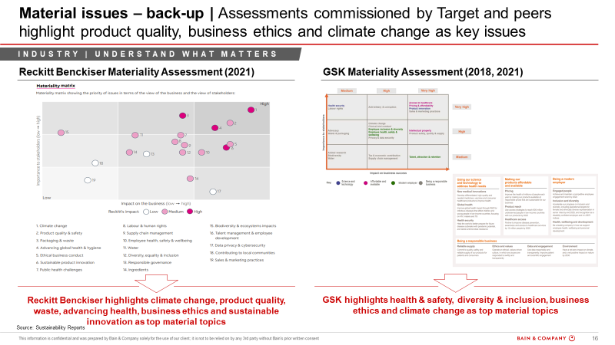
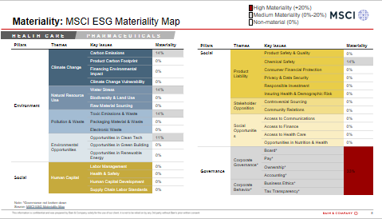
BCN PEG compliments the ESG Rave on materiality by adding an additional peer lens and providing a summary answer on materiality in the Bain ESG framework
ESG
Materiality
While the Rave offers material issues from Ecovadis and MSCI
BCN PEG includes additional peer lens in identifying material issues
To provide a collated view of ESG issues for the industry in focus
The additional peer lens helps specifically for industries where a direct industry match is not available on Ecovadis/MSCI
Industry and sector level analysis:
Assess the target’s industry and sector on ESG risk overall vs other industries
Determine the weightage of each of the three components: Environment, Social, Governance for the relevant sector
Identify the most important / high risk metrics for the sector and call out any hot topics or red-flags

Slide 4








BCN PEG benchmarks the target vs its peers and identifies key value creation levers for the target to improve ESG performance thereby mitigating risks
ESG
Benchmarking & Value creation
Benchmarking Target vs Peers
Value creation for Target
Methodology
Target company level analysis :
Establish a peer-set to compare the target to
Compare the target’s overall ESG score and score on each of the three components to the industry benchmark and that of the peer-set
Compare the target’s performance to the industry benchmark and the peer-set on the high-risk metrics identified
Analyze sector/product level drivers of the risk factors, industry best practices for important metrics and initiatives undertaken by the target company
Identify opportunities and specific recommendations for the target, along with feasibility of implementation and criticality or potential impact
Target company level analysis :
After establishing the peer set, we deep dive into the target’s key initiatives to look for value creation opportunities
Deep dive into benchmarking to compare the target’s initiatives with the peers to identify gaps in ESG performance
Identify and summarize potential value creation levers to improve ESG performance across high risk ESG themes
Target & Peer set (Processed Food Industry)
Target
Peer Set
UK based food company, with annual revenue of ~$1.1B
The peer-set consists of 5-10 companies in the packaged food industry, with annual revenue in a relatable range
Note: Persefoni cost would be additional

Slide 5
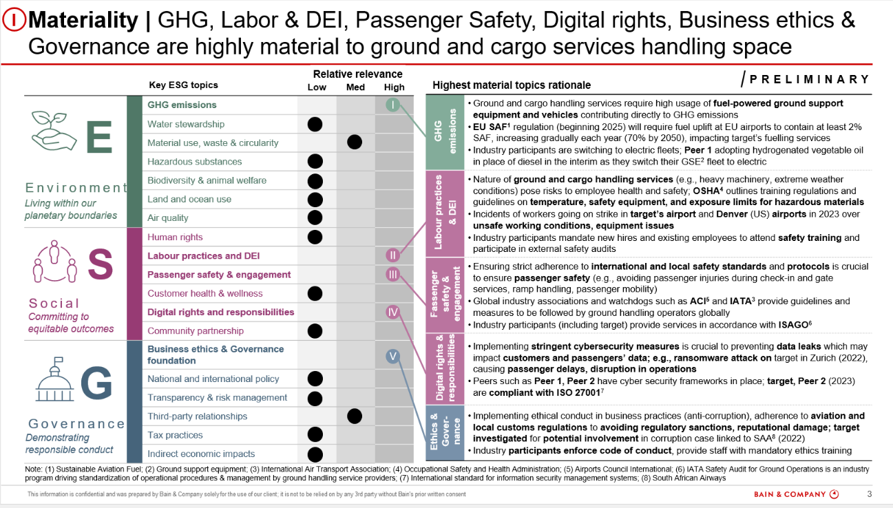
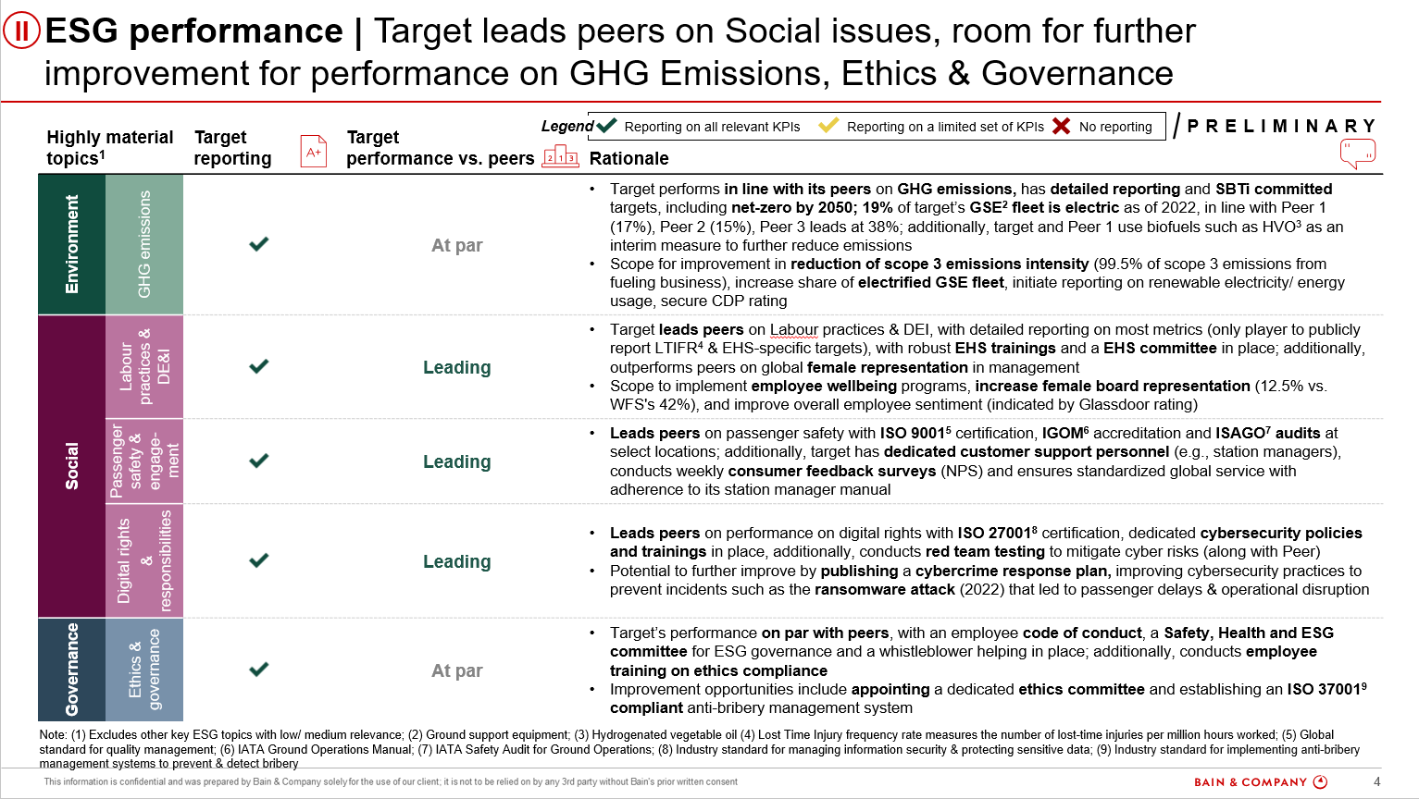
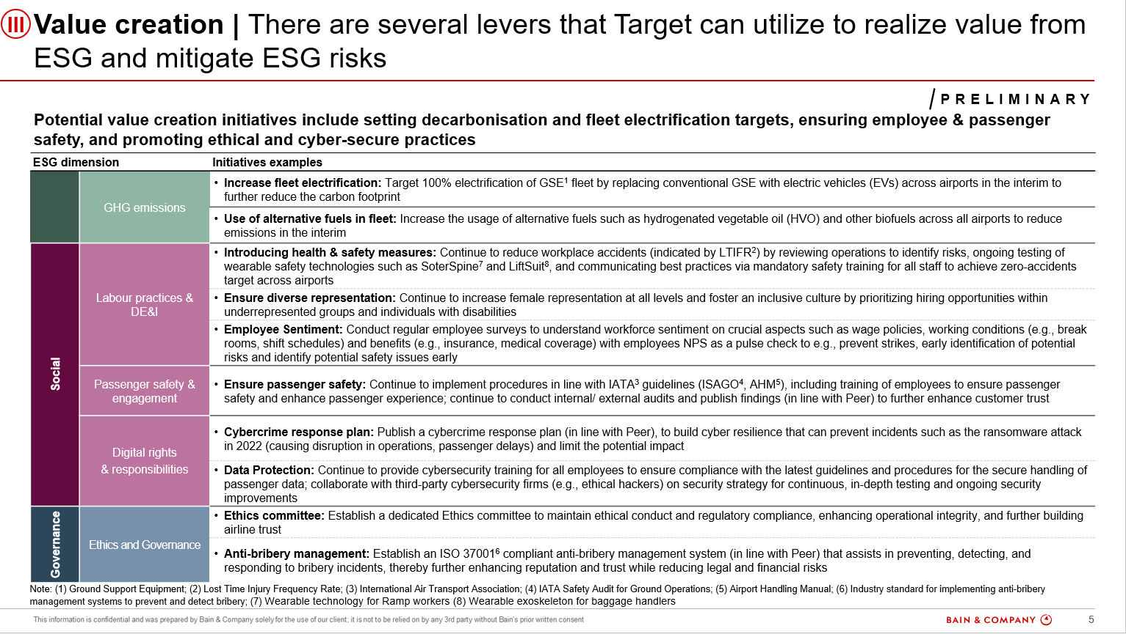
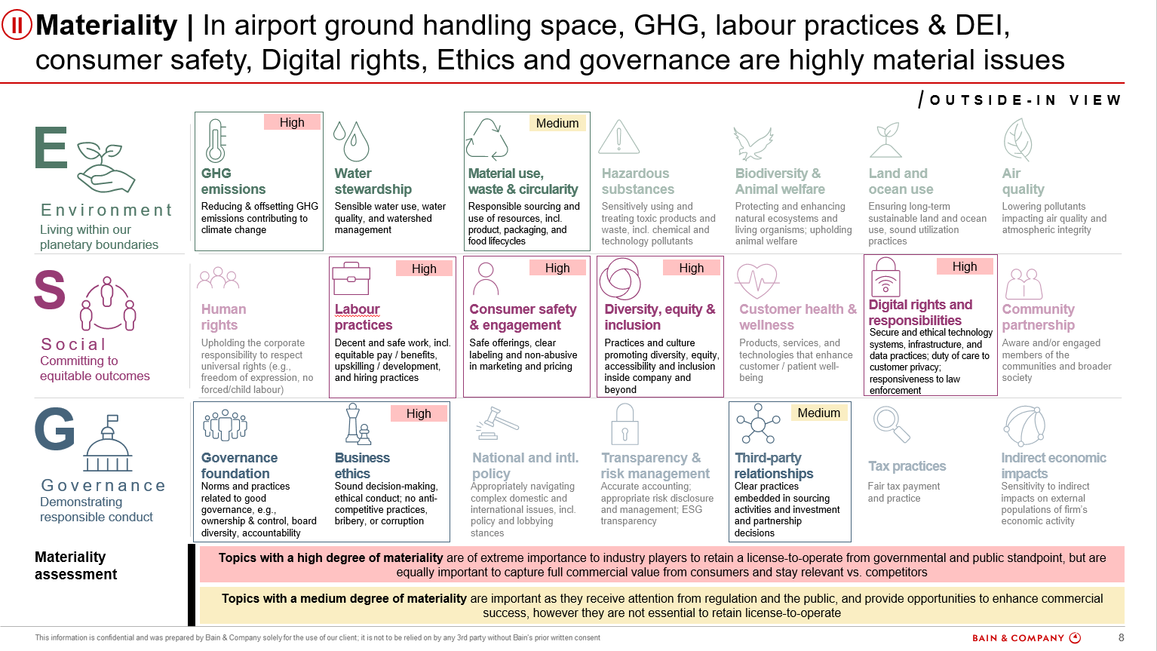
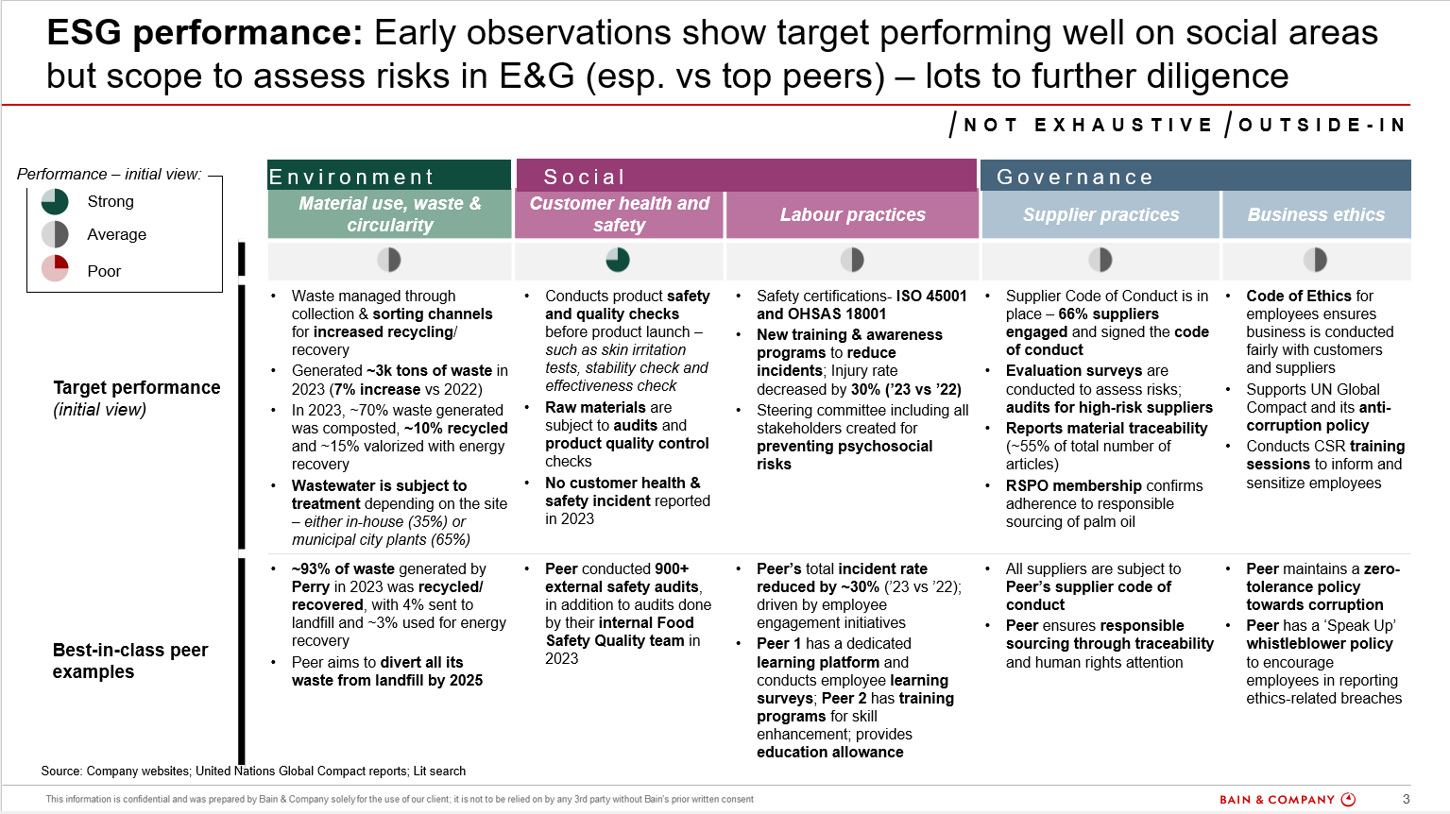
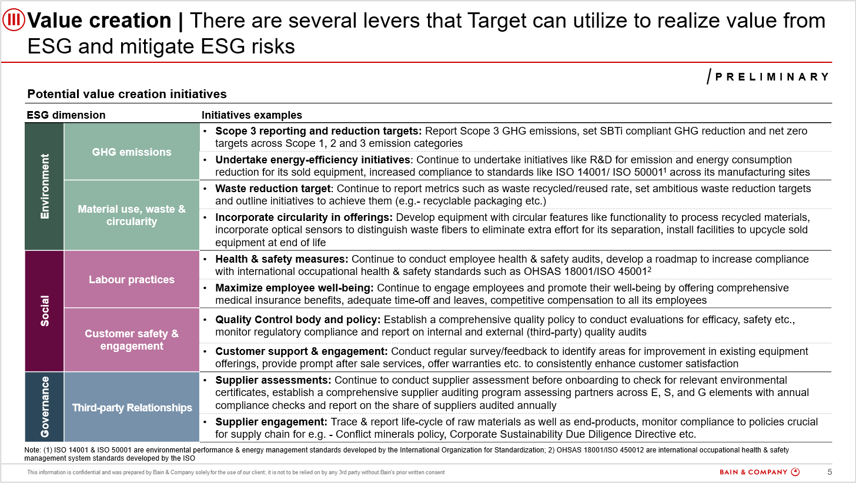
ESG ODA Sample Output
ESG Materiality
Benchmarking
Value creation
Understand key material ESG risks in the Target’s industry and their level of materiality from regulatory and peer lens
Benchmark Target’s ESG performance with the related peers in the industry via key quantitative & qualitative metrics across ESG topics
Deep dive on benchmarking to identify best-in-class practices and potential value creation levers for the Target
Note: Persefoni cost would be additional

